Slide 1
Angular 16
Angular 16 features

Slide 2
Upgrade to angular 16
To upgrade should do
- ng update @angular/cli @angular/core
-requires TypeScript version 4.9.3 or later
-Angular v16 supports node.js versions: v16 and v18.
-Angular v16 supports Zone.js version 0.13.x or later.
- @angular/material version 16.0.3
This link may be useful for you when upgrading to angular 16
https://update.angular.io/?l=2&v=15.0-16.0

Slide 3
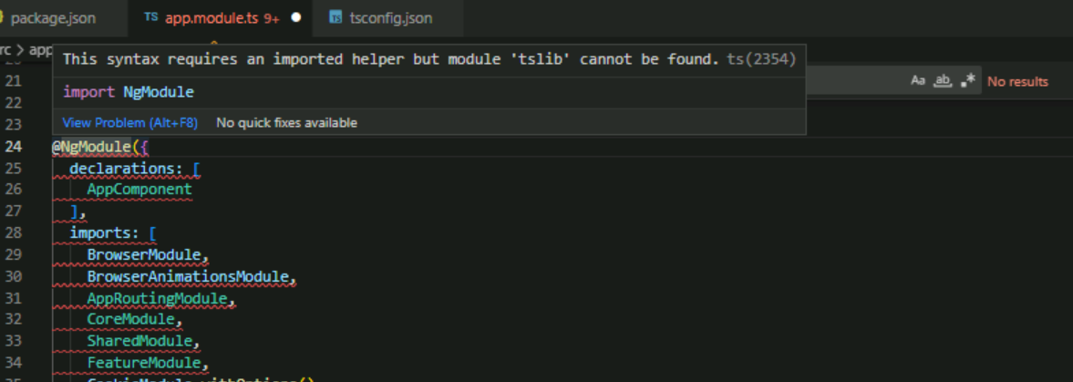
This error displayed when upgrade angular version
Fixed by install last verion of tslib and add this to compilerOptions in tsconfig.json
"paths": {
"tslib" : ["path/to/node_modules/tslib/tslib.d.ts"]
}

Slide 4
Angular 16 Features :
Angular Signals
RxJS interoperability
takeUntilDestroyed & DestroyRef
Server-side rendering and hydration (Non-destructive Hydration)
Required inputs
Self-closing tags
Passing router data as component inputs
Improvements to the CLI: Standalone, Jest and esbuild

Slide 5
Angular Signals
Signals are a new way of managing state changes in Angular applications.
Signals are functions that return a value (get())and can be updated by calling them with a new value (set()). Signals can also depend on other signals, creating a reactive value graph that automatically updates when any dependencies change.
Signals can be used with RxJS observables, which are still supported in Angular v16, to create powerful and declarative data flows.

Slide 6
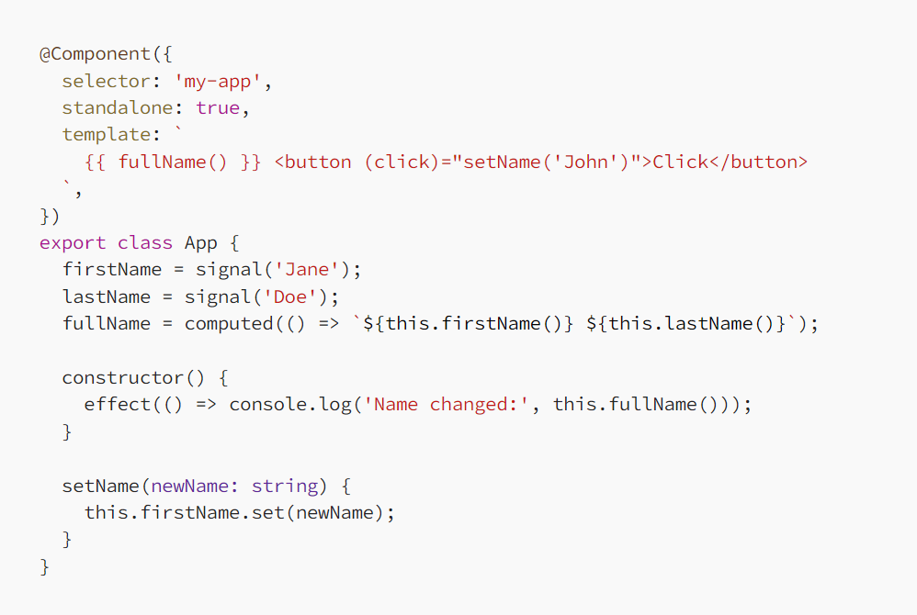
Example

Slide 7
The snippet above creates a computed value fullName, which depends on the signals firstName and lastName.
We also declare an effect, which callback will execute every time we change the value of any of the signals it reads — in this case fullName, which means it transitively also depends on firstName and lastName.
When we set the value of firstName to ”John”, the browser will log into the console

Slide 8
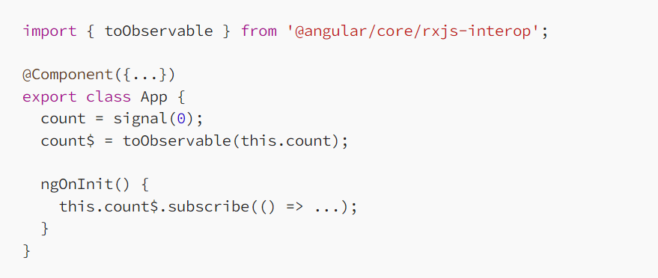
RxJS interoperability
You’ll be able to easily “lift” signals to observables via functions from @angular/core/rxjs-interop
Here’s how you can convert a signal to observable:

Slide 9
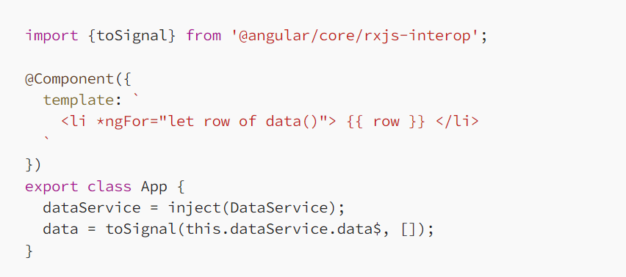
Convert an observable to signal to avoid using the async pipe:

Slide 10
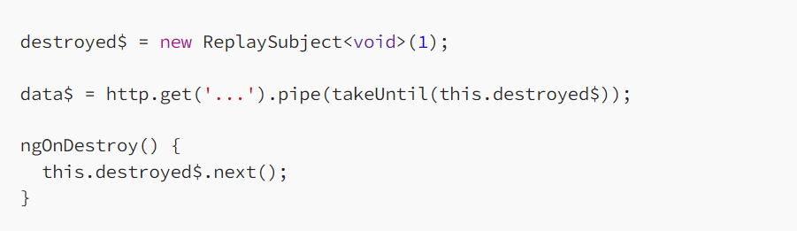
takeUntilDestroyed & DestroyRef
Angular users often want to complete a stream when a related subject completes.
takeUntilDestroyed pipe in angular16 will automatically unsubscribe from an observable when a component or directive is destroyed

Slide 11

We are introducing a new RxJS operator called takeUntilDestroyed, which simplifies this example into the following:

Slide 12
DestroyRef
This new feature allows you to inject DestroyRef corresponding to a component, directive, service or a pipe — and register the onDestroy lifecycle hook.
The scope of this destruction depends on where DestroyRef is injected. If DestroyRef is injected in a component or directive, the callbacks run when that component or directive is destroyed.
This can be useful for cleanup tasks that must be performed when a component is destroyed.

Slide 13
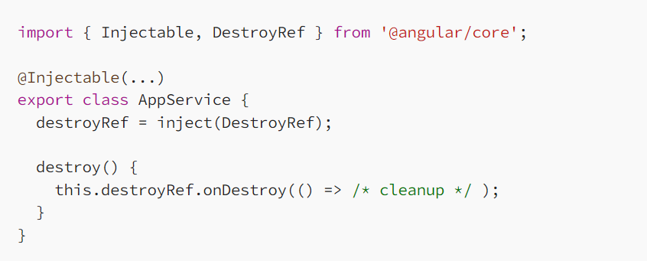

Slide 14
What the difference between destroyRef & ngOnDestroy?
It is called for cleanup logic when a component, directive, pipe or service is destroyed.
ngOnDestroy() is called just before component/directive is about to be destroyed by Angular.

Slide 15
Server-side rendering and hydration
the initial page load usually takes a few seconds longer than with classic web applications. This is because the browser has to load large amounts of JavaScript code in addition to the actual HTML page before it can render the page.
In the new full app non-destructive hydration, Angular no longer re-renders the application from scratch. Instead, the framework looks up existing DOM nodes while building internal data structures and attaches event listeners to those nodes.
Hydration making SSR(server side rendering) applications faster and smoother.

Slide 16
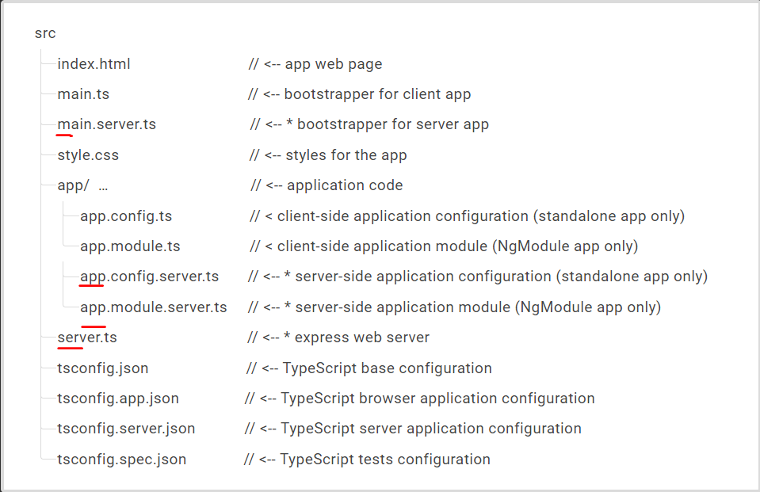
How do you enable hydration in Angular
Step 1. Enable Server-Side Rendering
-ng add @nguniversal/express-engine
The command updates the application code to enable SSR and adds extra files to the project structure (files that are marked with the * symbol).

Slide 17
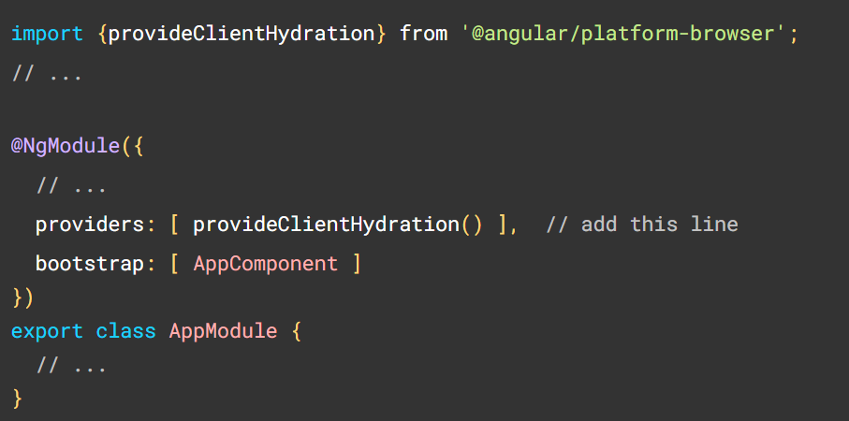
Step 2. Enable Client Hydration

Slide 18
Step 3. Start the server
-npm run dev:ssr
Step 4. Run your application in a browser
--Why use Server-Side Rendering?
Improve performance of the application
Show the first page quickly

Slide 19
Required inputs
One of the features that will improve the developer experience and code quality of Angular applications is the required component inputs feature.
This feature will allow developers to mark some inputs of a component as required, meaning the parent component must provide them, or else an error will be thrown.

Slide 20
cont.
Implementation:
@Input({ required: true }) item: Request;

Slide 21
Self-closing tags
This feature allows you to use self-closing tags for components in Angular templates.
-Now you can replace:
<component-name [prop]="someVar"></component-name>
-with this:
<component-name [prop]="someVar“/>

Slide 22
Passing router data as component inputs
The developer asking for the ability to bind route parameters to the corresponding component’s inputs
Now you can pass the following data to a routing component’s inputs:
Route data — resolvers and data properties
Path parameters
Query parameters

Slide 23
The old way
constructor(private route: ActivatedRoute) {}
ngOnInit(){ route.queryParams.subscribe((params) => { const contact = params['contact’]; })
}
In routing
path: 'user/: contact ',

Slide 24
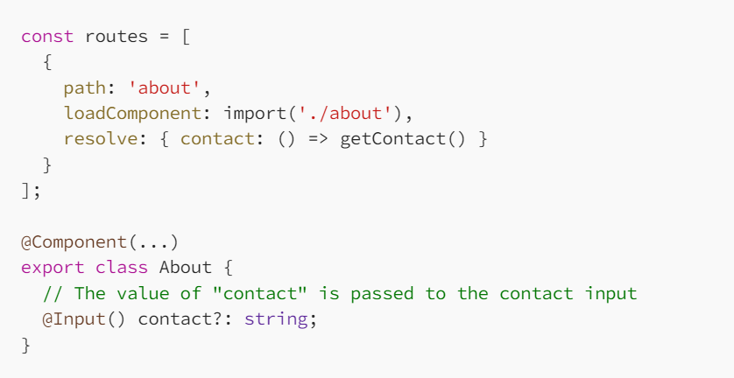
The new way
Here’s an example of how you can access the data from a route resolver:

Slide 25
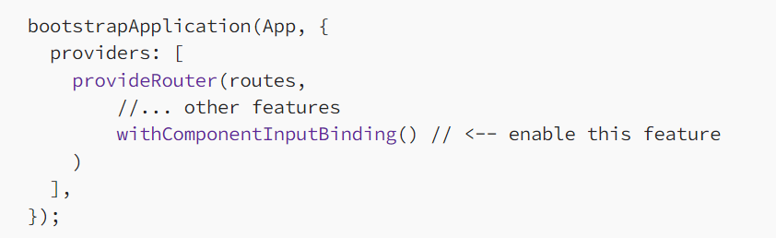
You can enable this feature by:
If we aren’t in a standalone application we need to enable it in the RouterModule:
RouterModule.forRoot(routes, { bindToComponentInputs: true })]
Or if we are in a standalone application, we can enable it like this:

Slide 26
Improvements to the CLI: Standalone, Jest and esbuild
Standalone: refers to components, directives, or pipes that can be used independently of NgModule
One of the benefits of Standalone Components is that they make Angular easier for new developers to learn and use, as they do not require an understanding of the NgModule concept.
It is now possible to generate standalone applications with the CLI,
--ng new my-app –standalone
You’ll get a simpler project output without any NgModules. Additionally, all the generators in the project will produce standalone directives, components, and pipes!

Slide 27
Cont.
To create standalone component use ng g c user –standalone
Use –standalone in create pipe & directive also
To support developers transitioning their apps to standalone APIs, we developed migration schematics and a standalone migration guide. Once you’re in your project directory run:
- ng generate @angular/core:standalone
The schematics will convert your code, remove unnecessary NgModules classes, and finally change the bootstrap of the project to use standalone APIs.

Slide 28
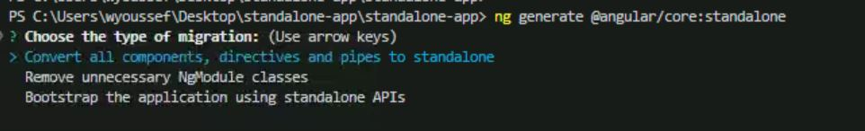
Run ng g @angular/core:standalone and select "Convert all components, directives and pipes to standalone"
Run ng g @angular/core:standalone and select "Remove unnecessary NgModule classes"
Run ng g @angular/core:standalone and select "Bootstrap the project using standalone APIs"
Run any linting and formatting checks, fix any failures, and commit the result

Slide 29
esbuild
The new builder that uses esbuild has been introduced in v14 but was experimental. It is now in developer preview.
esbuild in the Angular CLI make your builds faster
For a small application, on a cold production build (after ng cache clean), the build time went from 13s to 6s on my machine. For a larger application, the build time went from 1m 12s to 32s 🤯.
To check it out in your project, replace @angular-devkit/build-angular:browser with @angular-devkit/build-angular:browser-esbuild, and run ng build

Slide 30
Jest
The CLI now supports Jest as a test runner, but it is still experimental.
To check it out in your project, install Jest with
-npm install jest --save-dev –force
And replace @angular-devkit/build-angular:karma with @angular-devkit/build-angular:jest in angular.json, and run ng test.

Slide 31
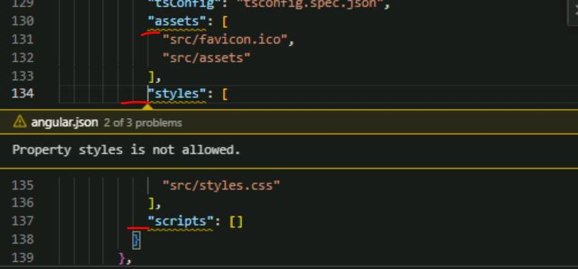
Cont.
While replace karma to jest you should remove assets,styles and scripts because are not allowed in jest

Slide 32
cont.
When run ng test this error displayed
Install jest-environment package using
-npm install jest-environment-jsdom --save-dev
Then run ng test
Jest does not run in a browser and uses JSDOM instead. That means that you don’t have the same experience that you can have with Karma, but as Karma is now deprecated, an alternative is welcome.

